Slide 1
VIDEO UNDERSTANDING · DASHCAM
Crash Prediction & Detection
from Dashcam Video
ResNet18 features + Chain-LSTM · Nexar collision dataset

Slide 2
PROBLEM & DATA
Can we see a crash coming?
1,500
0.5 s
120
1,344
videos (balanced)
frame step
frames per video (60 s)
external test clips
Prediction
See only frames before the crash → will it happen?
Detection
See frames after the crash → did it happen?
Label = time_of_event exists · Prediction: 1275 / 225 + 1,344 external test · Detection: 1020 / 180 / 300

Slide 3
STEPS & TOOLS
Pipeline
1
2
3
4
5
Download
›
Sample frames
›
Extract features
›
Cache
›
Train & evaluate
huggingface_hub
retry on failure
OpenCV
every 0.5 s · 224×224
ResNet18 (frozen)
layer3 + 2×2 pool
1024-d · fp16 .npz
1 file per video
PyTorch · scikit-learn
matplotlib
Made it run on free Colab + slow internet
Download → read → delete video
Features cached, resumable
4 download threads
fp16 inference

Slide 4
METHOD
Chain-LSTM model
Features + Δ
2048-d
Linear + ReLU
128-d
3 chained LSTMs
20 steps each
FC + sigmoid
P(crash) per step
›
›
›
Predict
Positive = 3 steps (1.5 s) before crash
Detect
Positive = 6 steps (3 s) after crash
Training
Weighted BCE
AdamW
Feature noise
Early stopping
5-seed ensemble

Slide 5
EVALUATION
How we measure
Video-level
Clip-level
Mean of top-3 smoothed scores
Score at ±0.5 / 1.0 / 1.5 s from the crash
Prediction: external clips end before the crash
Detection: whole video
Threshold τ tuned on validation
Normal videos use a random pseudo-crash time
Metrics: AUC and accuracy

Slide 6
RESULTS
Video-level results
Prediction (before)
Detection (after)
0.561
0.500
0.772
0.667
AUC
Accuracy (±0.03)
AUC
Accuracy (±0.05)
1,344 external test clips
300 internal test videos
So what? Detection reaches 0.77 AUC; prediction on the external test is near chance (0.56 AUC, 0.50 accuracy).

Slide 7
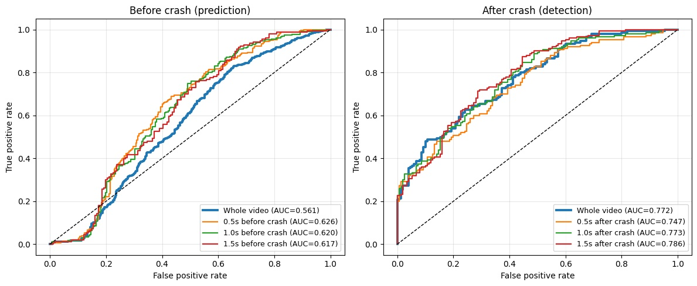
ROC CURVES
Detection is solid, prediction is weak
Whole: 0.56 / 0.77
Prediction near chance; detection matches its clips
Before: 0.63 → 0.62
Flat and weak at every distance
After: 0.75 → 0.79
Evidence keeps adding up after impact
So what? Detection works at every window; prediction stays near 0.62 even right before the crash.

Slide 8
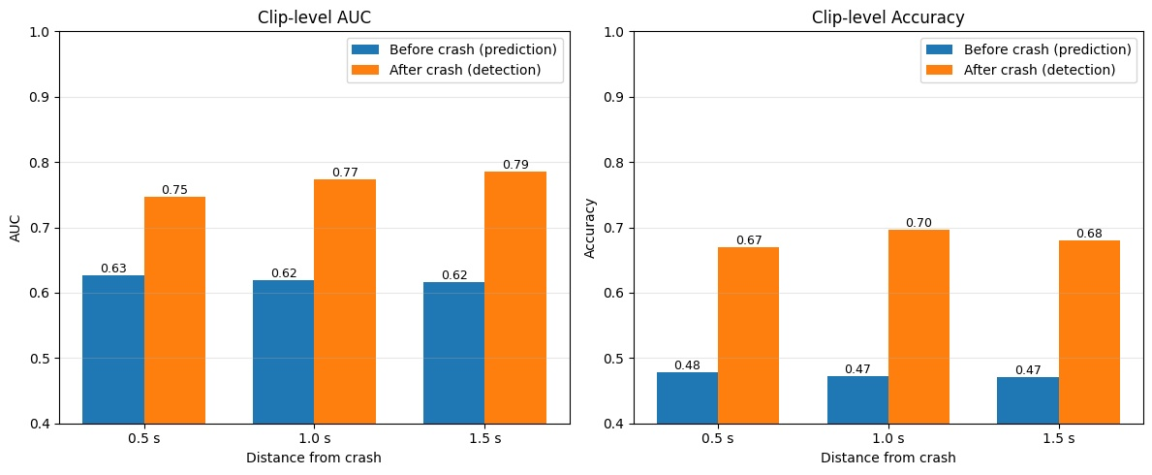
CLIP-LEVEL METRICS
Prediction stays weak, detection holds
0.5 s: +0.12 AUC
Detection 0.75 vs prediction 0.63
1.5 s: +0.17 AUC
Detection 0.79 vs prediction 0.62
Accuracy: 0.47 vs 0.68
Prediction is below chance; detection near 0.7
So what? Getting closer to the crash does not help prediction: AUC stays at 0.62–0.63 for all three windows.

Slide 9
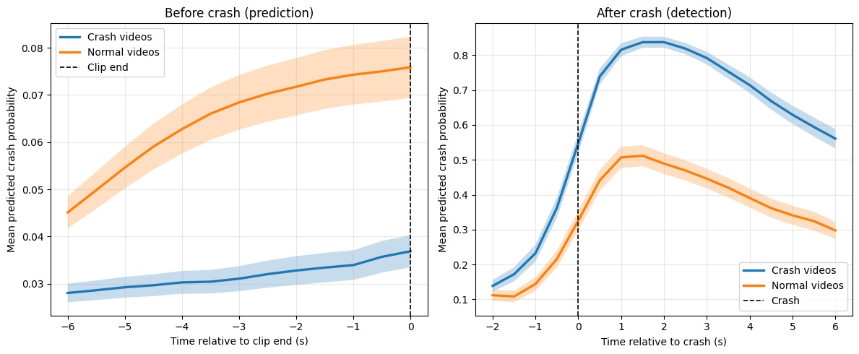
ALIGNED TO CRASH TIME
Detection sees the crash, prediction does not
Before: normal > crash
Normal clips score 0.05–0.08, crash clips only 0.03–0.04
After: peak 0.84
Peak at +1.5 s; sharp jump at impact, then decay
Clear gap after impact
Crash 0.84 vs normal 0.51 at peak (shaded = SE)
So what? Before impact the mean curves are inverted (normal scores higher), which likely explains the weak prediction AUC.

Slide 10
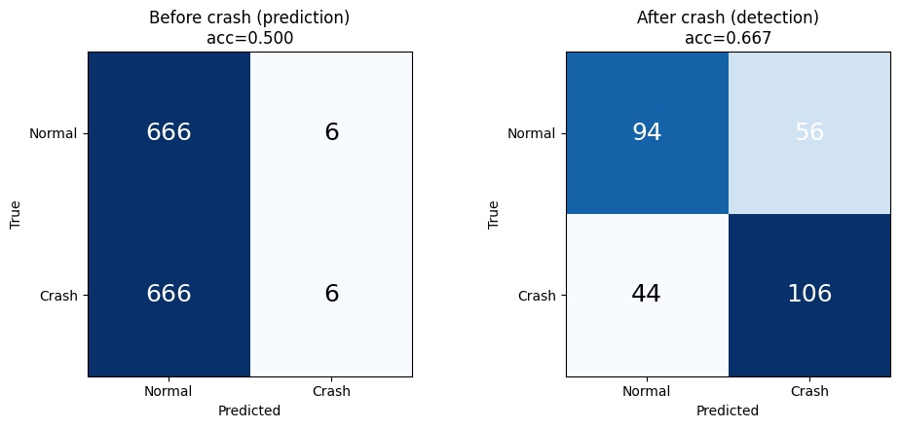
CONFUSION MATRICES
Prediction rarely fires; detection is balanced
Prediction: almost silent
Only 12 of 1,344 clips flagged; accuracy 0.500
Detection: recall 71%
106 / 150 crashes caught, 44 missed
And 56 false alarms
Specificity 63%: 94 / 150 normal videos correct
So what? Detection is the usable model. The prediction threshold, tuned on validation, almost never fires on the external test.

Slide 11
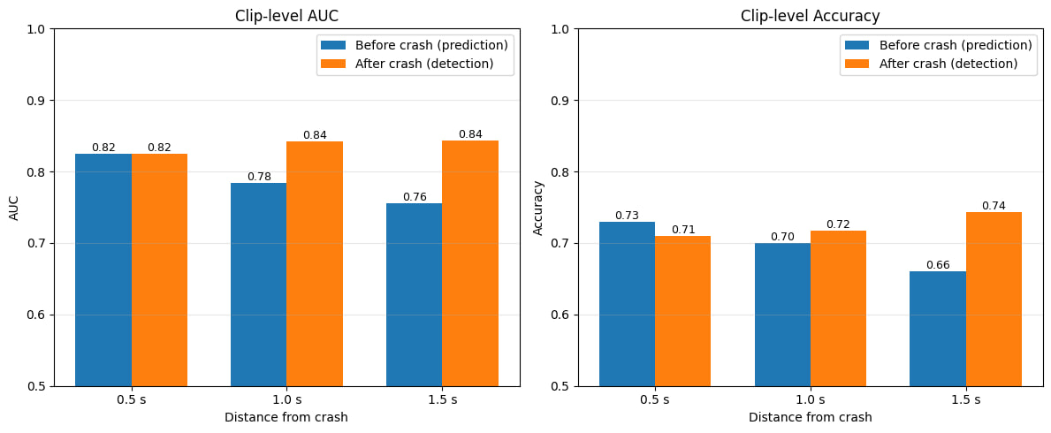
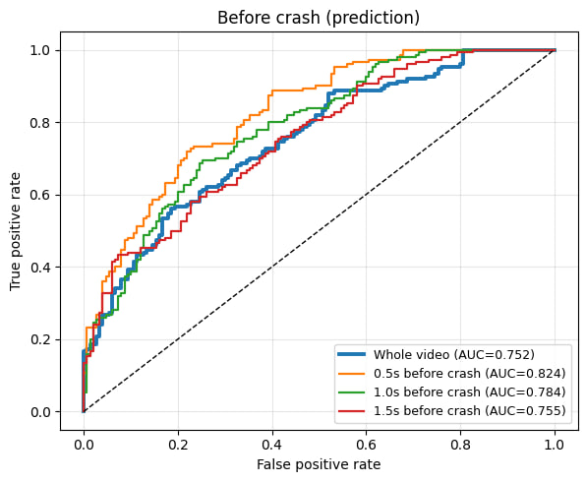
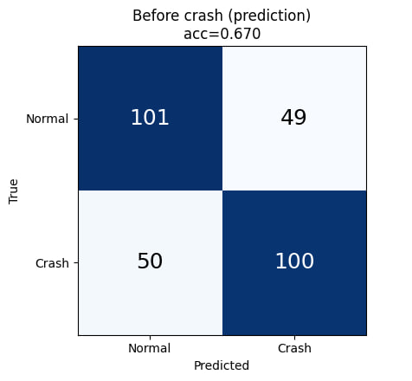
Early run: evaluated on a 300-video split of our own training data.
Our first results were optimistic
Our mistake
We did not know the dataset had a separate test set. We held out 300 of the 1,500 training videos and tested on them.
What it showed
Prediction: AUC 0.75, accuracy 0.67. Detection: AUC 0.74, accuracy 0.64. Clip AUC for prediction was 0.82 at 0.5 s.
What changed
On the real external test (1,344 clips), prediction drops to AUC 0.56. Detection stays solid at 0.77.

Slide 12
WRAP-UP
Conclusions
Works
Limits
Next
Detection reaches 0.77 video AUC and 0.79 within 1.5 s after a crash.
Prediction is near chance on the external test (0.56 AUC); normal clips score higher than crash clips.
Add motion cues (optical flow) or DINOv2 features, fine-tune the backbone. LSTM depth did not matter in CV.

